Slide 1

Raspberry Pi Sound Board
UTA EE Lab Workshops

Slide 2
PowerPoint and code
The PowerPoint, code and associated files can be found on our GitHub Page.

Slide 3
Setup
Plug in the HDMI, Network, Keyboard and Mouse.
Apply power.
Check VNC viewer to get the Rpi IP address.
Turn off the Rpi
Plug all cables back into the computer.
Power on the Rpi without cables.
Use your laptop to open VNC viewer to remote control the Raspberry pi.
If you have any issues, Download the Raspberry Pi Intro.ppt form the GitHub page to troubleshoot.

Slide 4
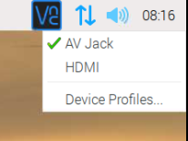


Ensure Audio is selected to AV Jack
Once your VNC View is up and running…
Right Click the speaker icon in the upper right corner and select AV Jack.
Open the File Explorer and go to the pi directory. Create a folder named soundboard.
Goto ->Programming -> Geany.
In Geany, select file-> new. Save the new file as soundboard.py and save it to Home/Pi/Soundboard directory.

Slide 5
Copy and Paste soundboard.py into the blank file
Type in the following code
import pygame.mixer from time import sleep import RPi.GPIO as GPIO from sys import exit GPIO.setmode(GPIO.BCM) GPIO.setup(23, GPIO.IN) GPIO.setup(24, GPIO.IN) GPIO.setup(25, GPIO.IN) pygame.mixer.init(48000, -16, 1, 1024) sndA = pygame.mixer.Sound(“Horse.wav") sndB = pygame.mixer.Sound(“Dog.wav") sndC = pygame.mixer.Sound(“Drum.wav") soundChannelA = pygame.mixer.Channel(1) soundChannelB = pygame.mixer.Channel(2) soundChannelC = pygame.mixer.Channel(3)
print ("Sampler Ready.“) while True: try: if (GPIO.input(23) == True): soundChannelA.play(sndA) if (GPIO.input(24) == True): soundChannelB.play(sndB) if (GPIO.input(25) == True): soundChannelC.play(sndC) sleep(.4) except KeyboardInterrupt: exit()
Notes:
# https://sourceforge.net/p/raspberry-gpio-python/wiki/Examples/

Slide 6
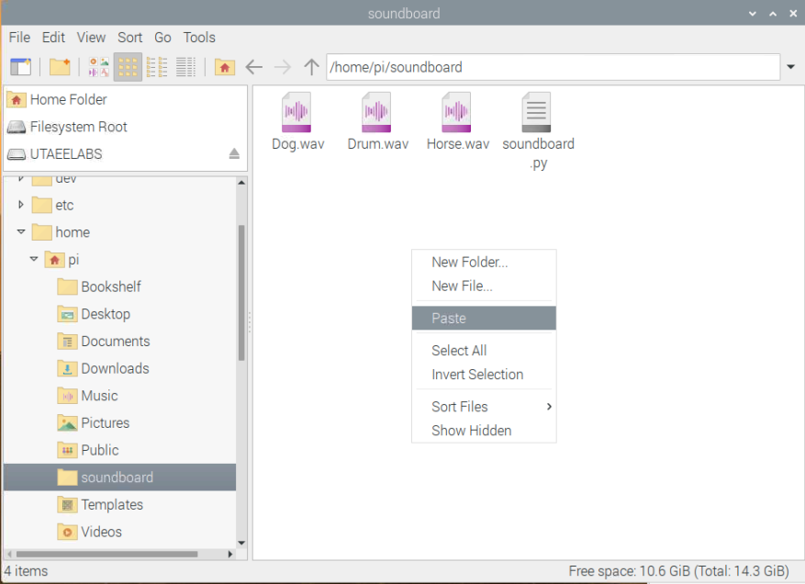
Add the .wav files
Download the WAV files from the GitHub page.
Save to the soundboard directory

Slide 7
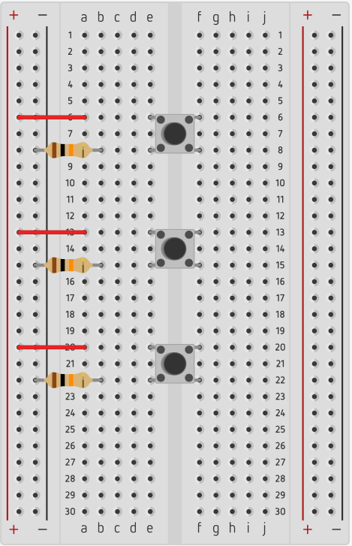
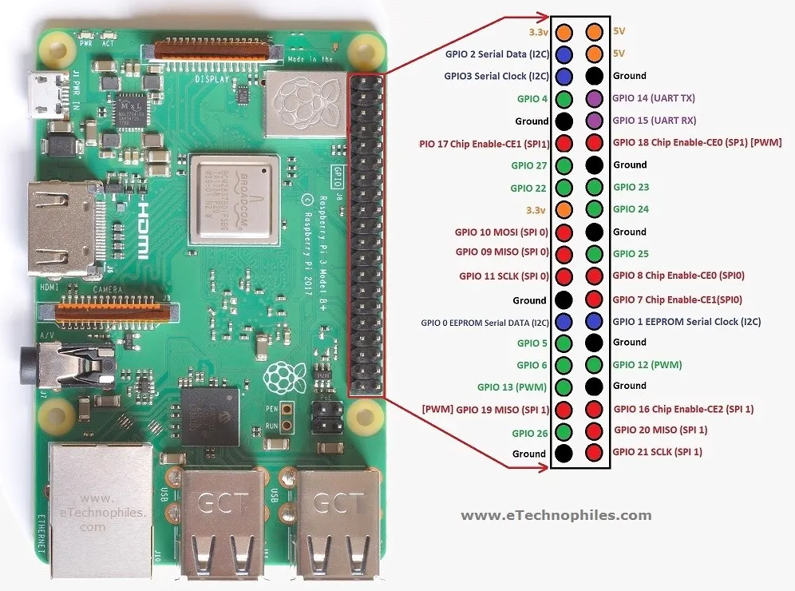
POWER OFF! GPIO 23,24,25 3.3V and Ground

Slide 8
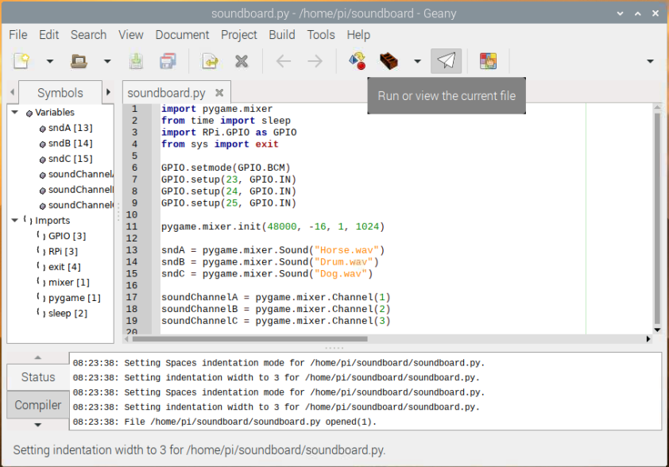
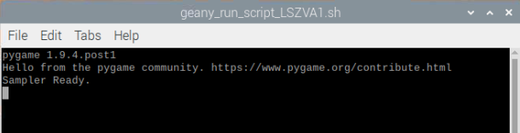
Run your program
A command window should open if the
Program is working
Push the buttons to play the sound.
Press CTRL + C to exit

Slide 9
Find some other sound files and edit your code to play them.
Try using ffmpeg -i input.mp3 output.wav in the terminal to convert mp3’s to wav files.
Try using lame --decode yourfile.mp3 yourfile.wav in the terminal to convert mp3’s to wav files.

Slide 10
Clean up your Pi
Set the Audio Output back to HDMI
Delete the wav files and program
Delete the soundboard folder.
Return breadboards, parts, Pi’s, etc

Slide 11
Stay tuned
In the Third Raspberry Pi workshop we will attach a touch screen display and program a custom GUI ( Graphical User Interface ).

